Slide 1
Illumination

Slide 2
Basic Terms
Illumination: the transport of energy from light sources to surfaces & points
Local illumination
Global illumination
Lighting model or Illumination model: Express the factors determining a surface’s color or luminous intensity (outgoing or reflected light) at a particular 3D point
Notes:
We calculate intensity of a point (light reflected from that point)

Slide 3
Components of Illumination
Two components of illumination:
Light sources
Surface properties
Light source described by a luminance/intensity ‘I’
Each color is described separately
I = [I r I g I b ] T (I for intensity)
Types of Light Sources:
Ambient Light
Diffuse Light
Spot Light

Slide 4
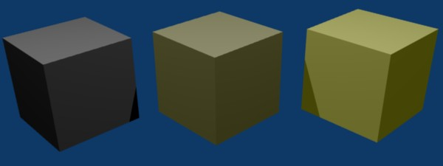
Ambient Light
No identifiable source or direction
Product of multiple reflections of light from the many surfaces present in the environment
Computationally inexpensive
Notes:
The scenes we observe around us always seem to be bathed in some soft non-directional light → Ambient light
Global ambient light – sunlight comes through window, get reflected from several surfaces
Local ambient light – tube light get reflected from several surface

Slide 5
Ambient Light
Categories:
Global ambient light
Independent of light source
Lights entire scene
Example: reflection of sunlight from several surfaces
Local ambient light
Contributed by additional light sources
Can be different for each light and primary color
Example: Reflection of fluorescent lamps from several surfaces
Notes:
The scenes we observe around us always seem to be bathed in some soft non-directional light → Ambient light
Global ambient light – sunlight comes through window, get reflected from several surfaces
Local ambient light – tube light get reflected from several surface

Slide 6
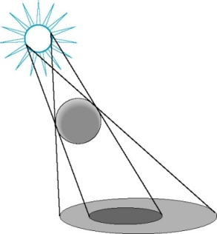
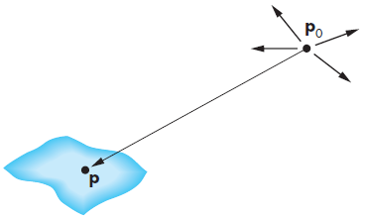

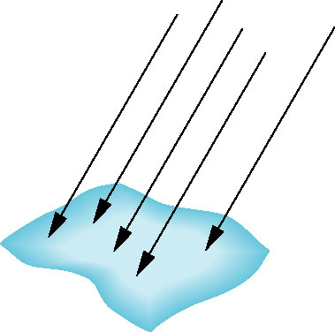
Diffuse Light
Point Source
Given by a point
Light emitted equally in all directions
Intensity decreases with square of distance
Point source [x y z 1]^{T}
At point p, intensity received
Directional Source
Given by a direction
Simplifies some calculations
Intensity dependents on angle between surface normal and direction of light
Distant source [x y z 0]^{T}
Notes:
Point Source: I is proportional to 1/d²

Slide 7
Ambient light vs Diffuse light
Diffuse light
Ambient Light

Slide 8
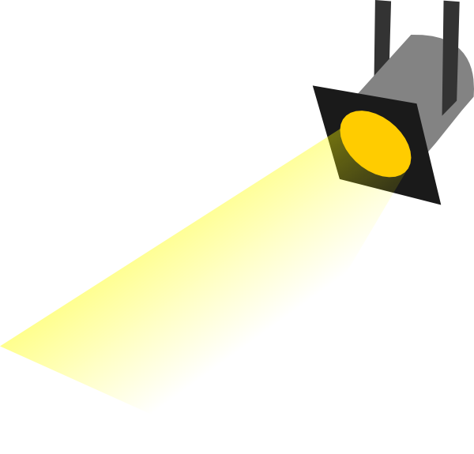
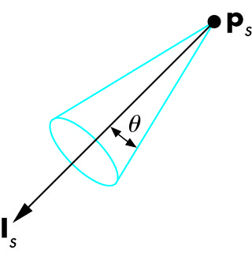
Spot Light
Spotlight is a point source that emits light in restricted set of directions,
Requires color, point, direction, falloff parameter
usually direction boundary forms a cone shape.
Here θ is Cutoff Cone. No light is seen at points lying outside Cutoff angle.
Intensity falls off directionally

Slide 9
Spot Light
Consider, a spot light aimed at direction d.
β is the angle between aimed direction d and a line from source to object P
Source has cut off angle α and intensity I
Intensity of spot light received at P is
Intensity at P = I cos^{ε}(β)
α
d
β
P

Slide 10
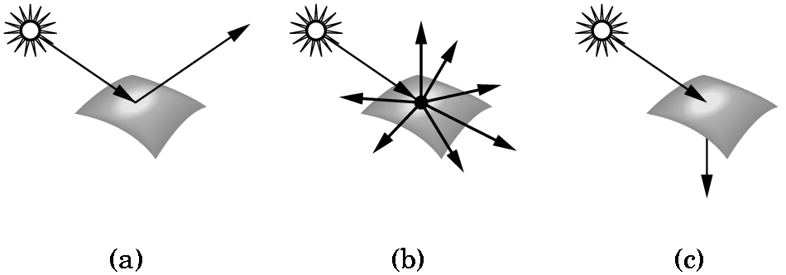
Types of surface
Interaction between light and material can be
classified as
Specular surfaces – Ideal mirror
Diffuse surfaces – Reflected light is ideally reflected to all directions uniformly
Translucent surfaces – allow some lights to penetrate the surface – refraction – glass, water
Notes:
So far what we have seen is the intensity of incident light at some surface point. Now we will compute intensity of reflected light at some surface point.
Spec: incident light is fully reflected

Slide 11
Reflection
Defuse Reflectance, Specular Reflectance
Notes:
We mainly calculate intensity of reflected light

Slide 12
Ideal Diffuse Reflectance
Assumes surface reflects equally in all directions.
An ideal diffuse surface is, at the microscopic level, a very rough surface.
Example: chalk, clay, some paints
Surface

Slide 13
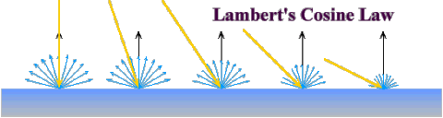
Ideal Diffuse Reflectance
Ideal diffuse reflectors reflect light according to Lambert's cosine law.
Lambert's law determines how much of the incoming light energy is reflected. The reflected intensity is independent of the viewing direction.
But reflected light intensity depends on incident angle of light.

Slide 14
Ideal Diffuse Reflectance
Suppose light is incident on diffuse surface S.
m = direction of Normal of the surface
v = viewer’s direction
s = direction of incident light
θ = incident angle
I_{s} = Intensity of Light Source
Intensity of reflected light, I_{d}
I_{d}= I_{s} Þ_{d} (s.m/|s||m|) , where Þ_{d} is the diffuse reflectance coefficient.
If θ is negative, then I_{d}= max(I_{s} Þ_{d} (s.m/|s||m|) ,0)
s
m
θ
v

Slide 15
Specular Reflection
Specular reflection accounts for the highlight that you see on some objects
It is particularly important for smooth, shiny surfaces, such as:
Metal
Polished stone
Plastics
Apples

Slide 16
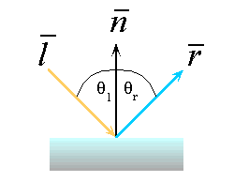
Ideal Specular Reflection
Reflection is only at mirror angle. An ideal mirror is a purely specular reflector.
View dependent reflection. That is, reflected light’s intensity varies with viewr’s position.
Intensity of refelcted light is strong near mirror angle and strongest at mirror angle.
An Ideal specular reflection follows Snell’s Law.
Snell’s Laws:
The incoming ray and reflected ray lie in a plane with the surface normal
The angle that the reflected ray forms with the surface normal equals the angle formed by the incoming ray and the surface normal.

Slide 17
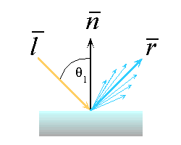
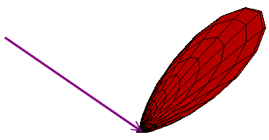
Non-ideal Reflectors
Simple Empirical Model:
We expect most of the reflected light to travel in the direction of the ideal ray.
However, because of microscopic surface variations we might expect some of the light to be reflected just slightly offset from the ideal reflected ray.
As we move farther and farther, in the angular sense, from the reflected ray we expect to see less light reflected.

Slide 18
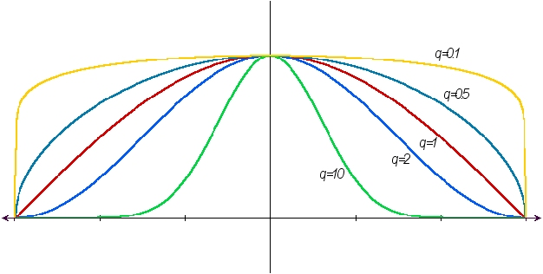
Non-ideal Reflectors
Phong model approximates the fall off of specular reflection.
The cosine term is maximum when the surface is viewed from the mirror direction and falls off to 0 when viewed at 90 degrees away from it.
The scalar n_{shiny} controls the rate of this fall off

Slide 19
Phong Model
Compute the combined impact of ambient, diffuse and specular reflectance at a point on surface
Also called Local Illuminatin model as its main focus is on the direct impact of light coming from a source.
This model has no physical basis, yet it is one of the most commonly used illumination models in computer graphics.

Slide 20
Phong Model
Also models secondary effect of light.
Consider a point light source p and viewpoint v. What should be color of light reflected into viewer’s eye from point Q of the surface?
Consider diffuse component, specular component of the incident light and ambient light present in the environment
N
P
R
V
L
θ
θ
φ
Q

Slide 21
Mathematical Calculation of Phong Model
First we consider, 2 extreme cases of light reflection.
Diffuse Reflection : I_{d} cosθ = I_{p} k_{d} cosθ = I_{p} k_{d} (L.N)
Specular Reflection:
I_{s} (cosφ )^{k} = I_{p} k_{s} (cosφ )^{k} ⁼ I_{p} k_{s} (R.V)^{k}
ᴕ
N
P
R
V
L
θ
θ
φ
ᴕ
Q

Slide 22
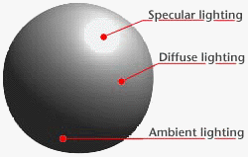
Mathematical Calculation of Phong Model
We need to ircorporate the effect light present in environment. Thus total refelcted light also includes ambient component.
Ambient Component = I_{a}k_{a}
Total reflected light intensity from Q,
I = Ambient Component + Diffuse Component + Specular Component
= I_{a}k_{a} + I_{p} k_{d} (L.N) + I_{p} k_{s} (R.V)^{k}
= I_{a}k_{a} + I_{p} [k_{d} max {(L.N),0} + k_{s} max{(R.V)^{k} ,0}]

Slide 23
Additional Issues
When there are n light sources in the scene, their effects are cumulative: Intensity at Q,
I = I_{a}k_{a} + ∑_{(i=1 to n)} I_{pi} {k_{d} (L.N) + k_{s} (R.V)^{k} }
The intesnsity of red, green and blue component of reflected light,
I_{r} = I_{a}k_{ar} + I_{p} k_{dr} (L.N) + I_{p} k_{s} (R.V)^{k}
I_{g} = I_{a}k_{ag} + I_{p} k_{dg} (L.N) + I_{p} k_{s} (R.V)^{k}
I_{b} = I_{a}k_{ab} + I_{p} k_{db} (L.N) + I_{p} k_{s} (R.V)^{k}
k_{s} is same as color of specular component is same as color of light source, not affected by surface color.

Slide 24
Effect of the reflection coefficients

Slide 25
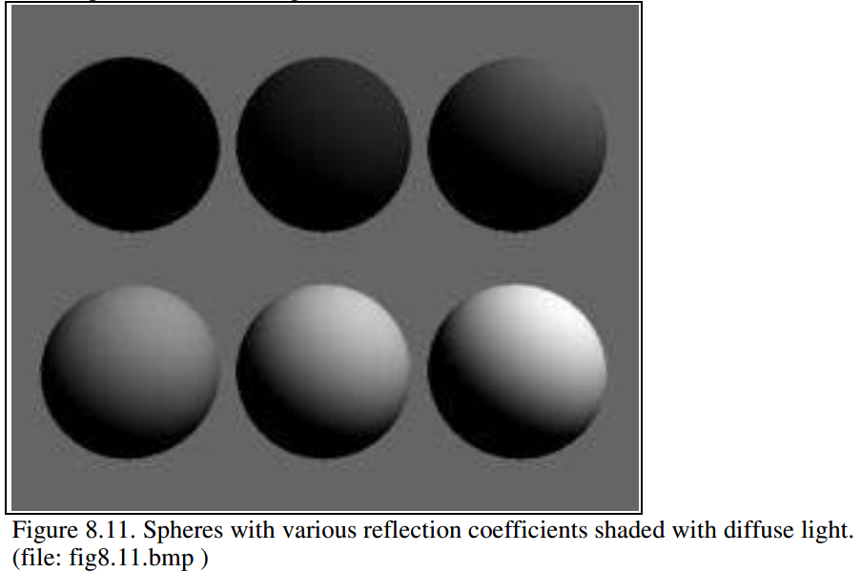
Diffuse Reflection Coefficient
I_{d} = max {I_{s} ρ_{d} cos ϴ,0}
Source intensity is 1.0
Background intensity is 0.4
Sphere reflecting diffuse light, for six reflection coefficients: 0, 0.2, 0.4, 0.6, 0.8, and 1.
Angle ϴ between surface normal and incident light is > 90º
Notes:
Note that the sphere is totally black when ρd is 0.0,
the shadow in its bottom half is also black. Since there the angle between surface normal and incident light is > 90 (dot product is negative)

Slide 26
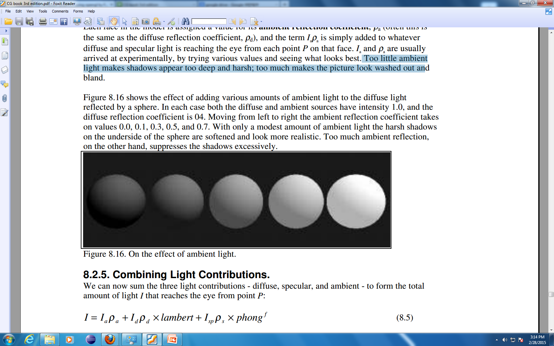
Ambient Reflection Coefficient
Effect of adding ambient light to the diffuse light reflected by a sphere
Diffuse source intensity is 1.0 Diffuse reflection coefficient is 0.4 Ambient source intensity is 1.0
Moving from left to right the ambient reflection coefficient takes on values: 0.0, 0.1, 0.3, 0.5, and 0.7
Too little ambient light makes shadows appear too deep and harsh
Too much makes the picture look washed out and bland

Slide 27
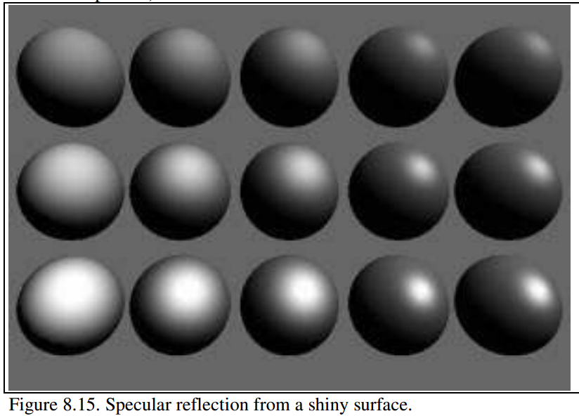
Specular Reflection Coefficient
The ambient and diffuse reflection coefficients are 0.1 and 0.4 for all spheres.
I_{d} = Is ρ_{s} cos(φ)^{f}
More shiny and more highly concentrated along the direction r
Exponent f
3
6
9
25
200
More mirror like, more focused reflection with increasing exponent
0.25
reflection coefficient ρ_{s}
0.5
0.75
Notes:
As f increases, the reflection becomes more mirror-like and is more highly concentrated along the direction r
The reflection coefficient ρs varies from top to bottom with values 0.25, 0.5, and 0.75
exponent: user-chosen value that controls the apparent smoothness of the surface. distribution of microfacet normals

Slide 28
Color

Slide 29
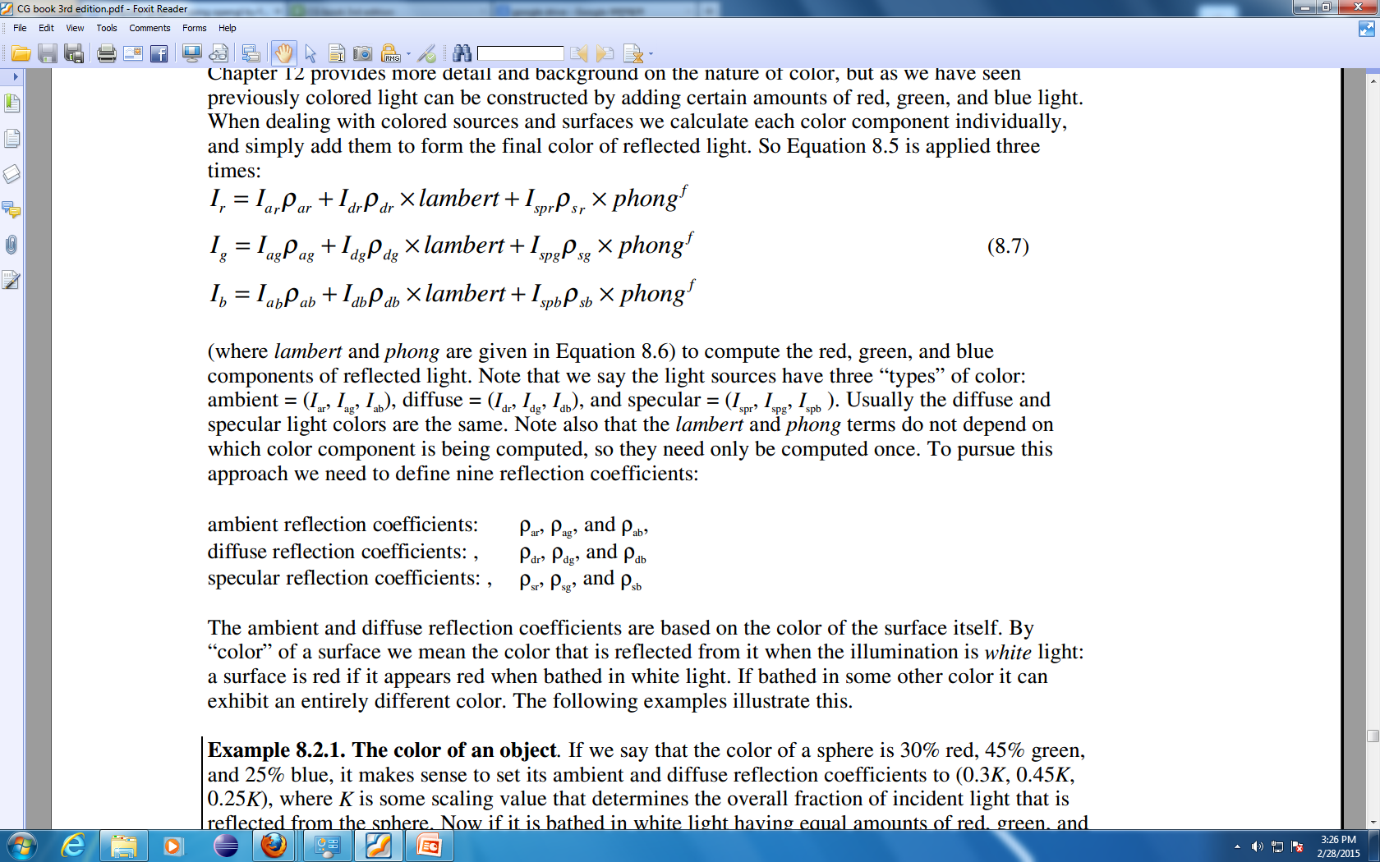
Adding Color
Color is constructed by adding certain amounts of red, green, and blue light
light sources have three “types” of color:

Slide 30
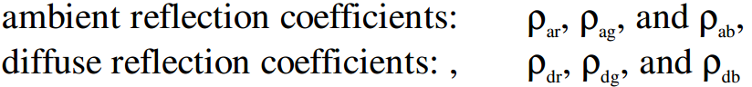
Adding Color
Surface has two sets of reflection co-efficient
Color of the specular component is often the same as that of the light source – mirror like: ρ_{sr} , ρ_{sg} , ρ_{sb} = ρ_{s}
Glossy red apple when illuminated by a yellow light is yellow rather than red

Slide 31
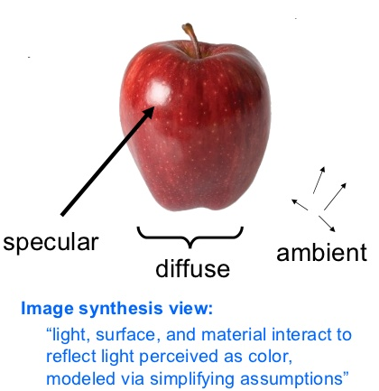
What makes an apple red?

Slide 32
Adding Color
By “color” of a surface we mean the color that is reflected from it when the illumination is white light
The ambient and diffuse reflection coefficients are based on the color of the surface itself.
Notes:
a surface is red if it appears red when bathed in white light. If bathed in some other color it can exhibit an entirely different color.

Slide 33
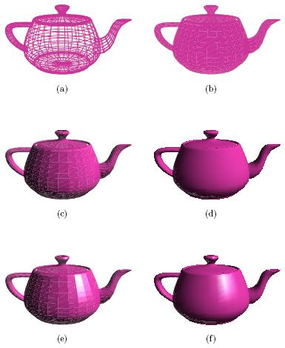
Color of an object
Color of a teapot is 40% red, 25% green, and 35% blue
Ambient light in environment: White light (Isr= Isg= Isb = I)
Sphere’s ambient and diffuse reflection coefficients: I_{ar}=I_{dr}=0.4K I_{ag}=I_{dg}=0.25K I_{ab}=I_{db}=0.35K
The individual ambient components have intensities: I_{ar}= 0.4 K I I_{ag}= 0.25 K I I_{ab}= 0.35 K I
Notes:
K is some scaling value that determines the overall fraction of incident light that is reflected from the sphere

Slide 34
Color of an object
Color of a teapot is 40% red, 25% green, and 35% blue
Diffuse light in environment : White light (Isr= Isg= Isb = I)
The individual Diffuse components have intensities: I_{dr}= 0.4 K I cos ϴ I_{dg}= 0.25 K I cos ϴ I_{db}= 0.35 K I cos ϴ
Diffuse Light
Notes:
K is some scaling value that determines the overall fraction of incident light that is reflected from the sphere

Slide 35
Color of an object
Color of a teapot is 40% red, 25% green, and 35% blue
For specular reflection,
Intensity of light Source I
Set ρ_{s} to .5 for a medium shiny object or more higher value for higher shiny object

Slide 36
Reddish Object in Greenish Light ?
Think!

Slide 37
Reference
Hill: 8.2.1 - 8.2.6

